Slide 1
PROBLEM
Have you ever wanted to know what time it is?
Have you ever wanted to be “Alarmed” to a specific time?

Slide 2
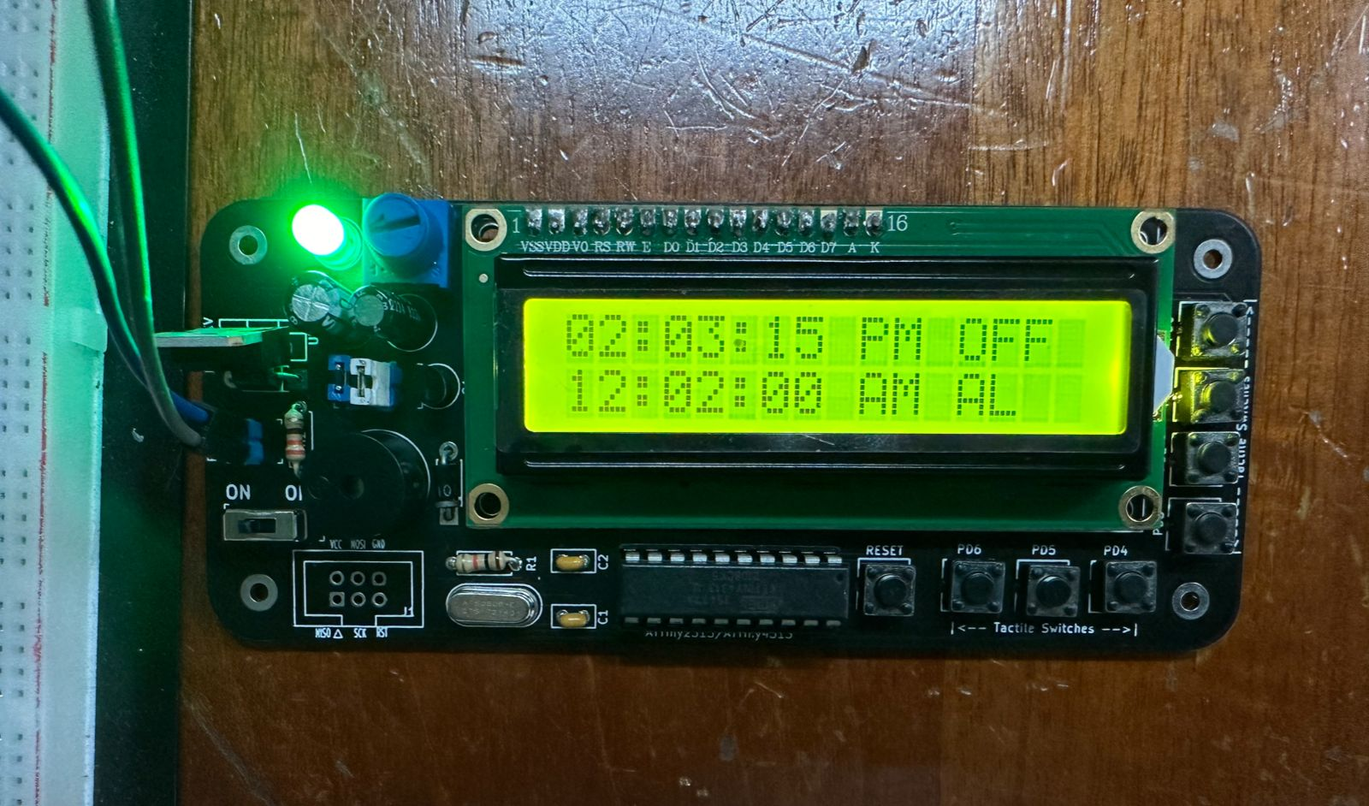

Slide 3
ACCURATE TIME DISPLAY
WHAT CAN
CLOCK
DO?
12HR AND 24HR FORMAT
ALARM

Slide 4
SET & DISPLAY THE CURRENT TIME
WHAT CAN
CLOCK
DO?
12HR AND 24HR FORMAT
ALARM

Slide 5
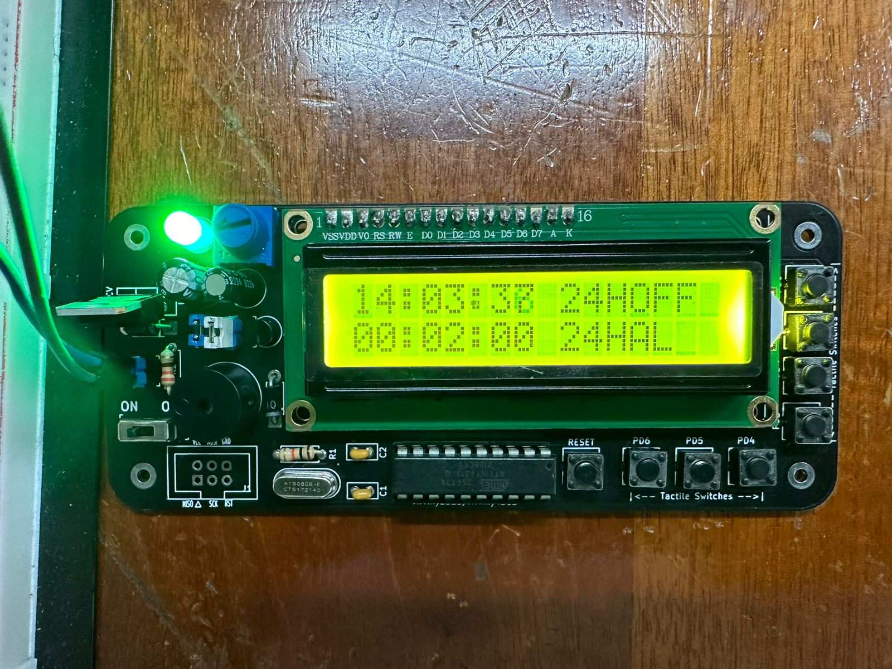
ACCURATE TIME DISPLAY
WHAT CAN
CLOCK
DO?
12HR AND 24HR FORMAT
ALARM

Slide 6
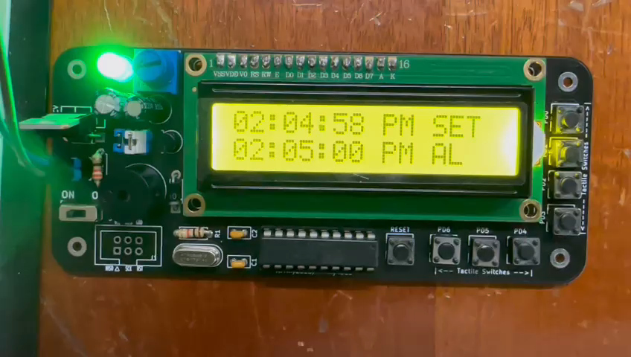
ACCURATE TIME DISPLAY
WHAT CAN
CLOCK
DO?
12HR AND 24HR FORMAT
ALARM

Slide 7
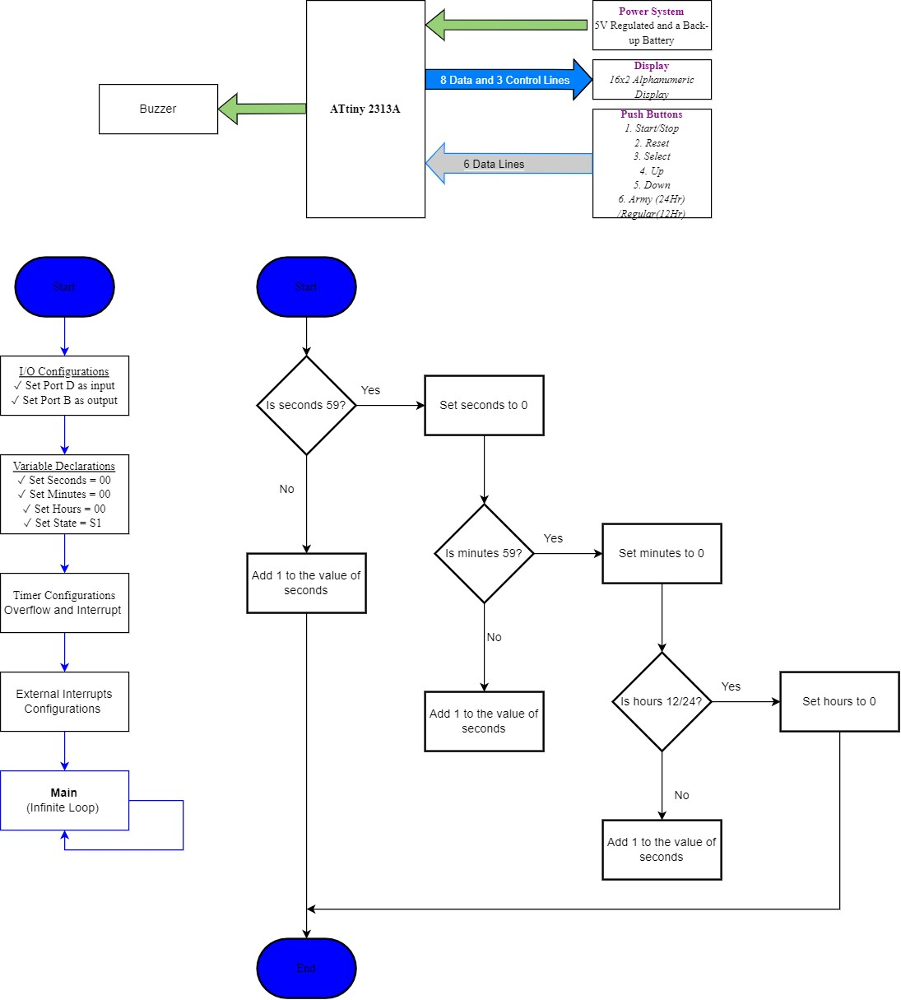
BLOCK DIAGRAM

Slide 8
FLOW CHART

Slide 9
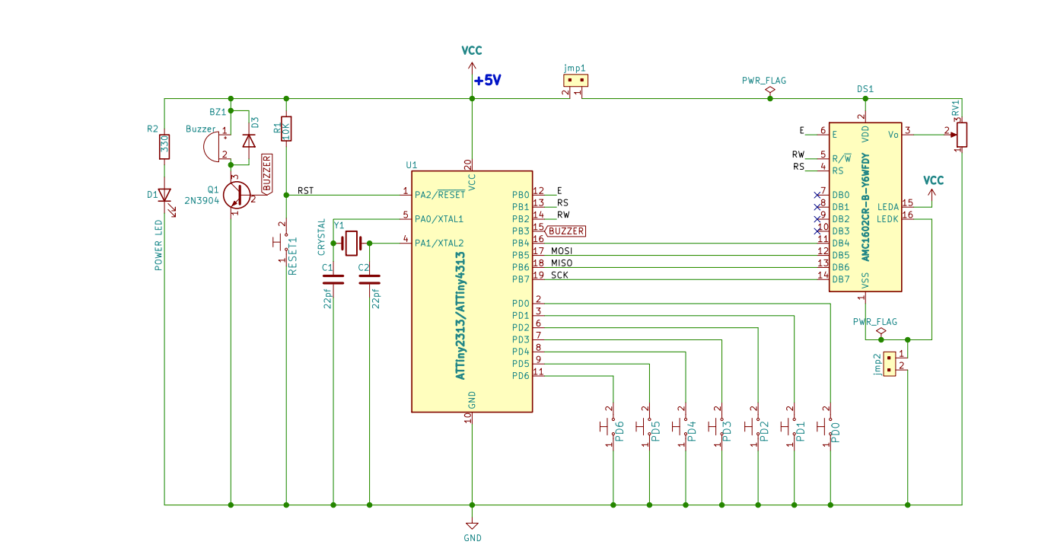
DEVELOPMENT PERIOD
SCHEMATIC DIAGRAM

Slide 10
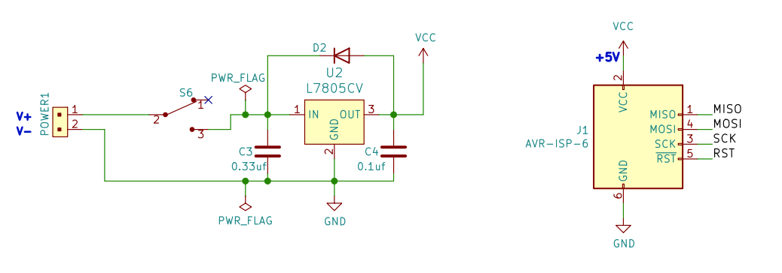
DEVELOPMENT PERIOD
Power Supply

Slide 11
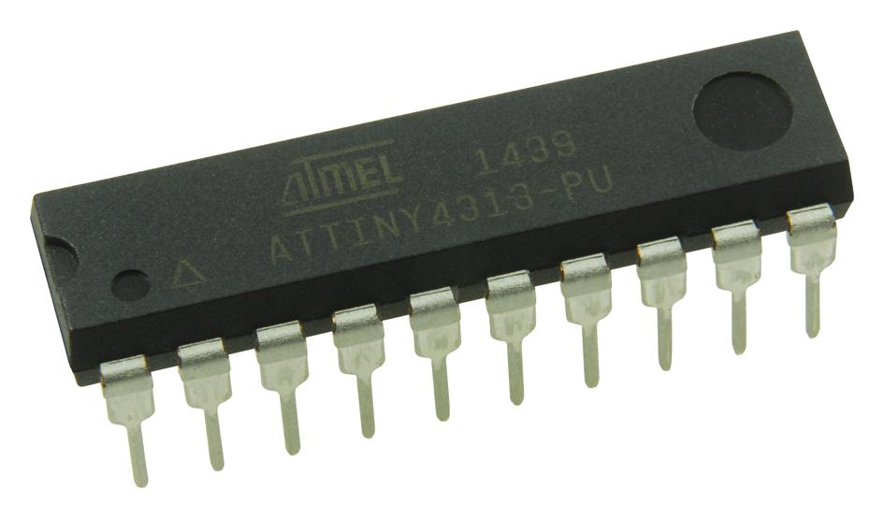

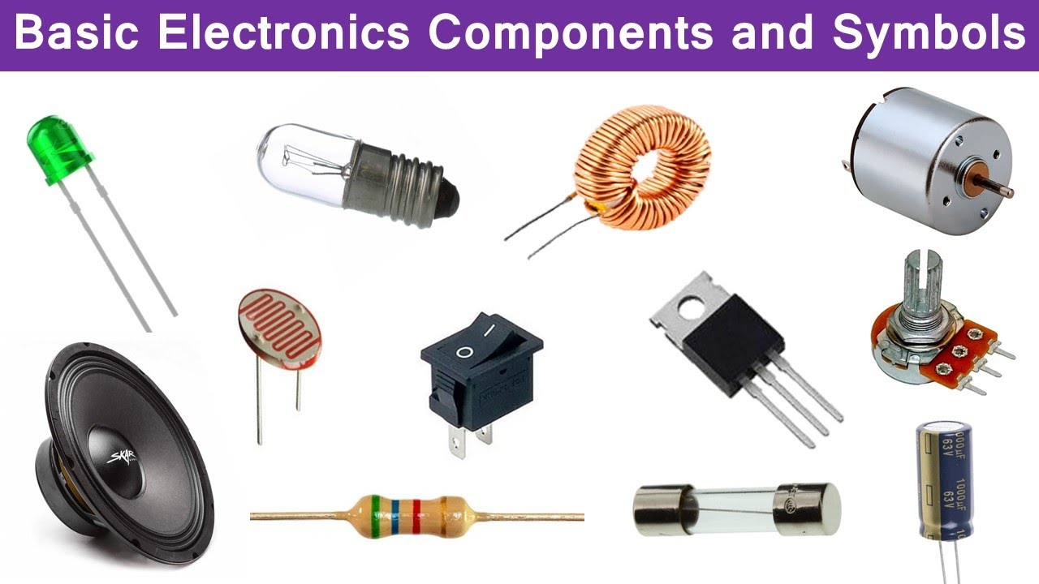
Components List

Slide 12
ATtiny 4313A
The ATtiny4313A is a microcontroller from the AVR family manufactured by Microchip Technology (formerly Atmel). It's part of the Atmel AVR 8-bit RISC-based microcontroller series, known for its low power consumption, simplicity, and versatility. A microcontroller is basically a computer on a single IC (integrated circuit).
Components List

Slide 13
C-CODE
Instructions are written and coded in the C programming language and then the microcontroller is programmed with said instruction to carry out the functionality. These instructions are written in Microchip Studio and are uploaded to the microchip using the Polou AVR
Components List

Slide 14
Other Components
Other Equipment
Breadboard- $2500
Twin and Earth wire- 1000
Transformer-$2000
Poloulu AVR Programmer- $1200
Plug (3 Prong)-$500
Project Kit
16x2 LCD
Crystal
Voltage Regulator
8 Pin Push Buttons
2 0.33uf capacitors
1 Diode
Speaker
Transistor
Switch
Microchip Holder
1 10K resistor
1 330 Resistor
Knobb Shifter
Connectro clips
PCB Bed
Diode
=$6000 JMD
Components List

Slide 15
TIMES UP!!!

